Slide 1

Career Paths in Computing
Open House Fall 2020
We’re Here for You!

Slide 2
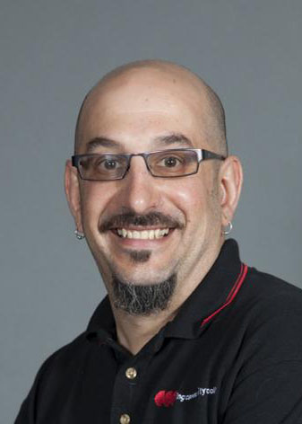
Teaching Faculty
  Chair of Technology, Engineering, and Computing: Joe DeLeone
  Professor, Cybersecurity, Information Technology, Physics
  Faculty Profile:
  https://www.corning-cc.edu/directory/delone-joseph.php
  email: deleone@corning-cc.edu
  e
Open House Fall 2020
We’re Here for You!

Slide 3
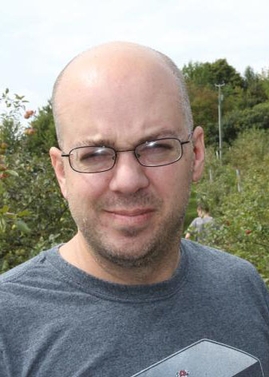
Teaching Faculty
  Associate Professor of Information Technology: Computers and Networking: DJ Dates
  Faculty Profile:
  https://www.corning-cc.edu/directory/dates-dj.php
  email: dates@corning-cc.edu
  e
Open House Fall 2020
We’re Here for You!

Slide 4
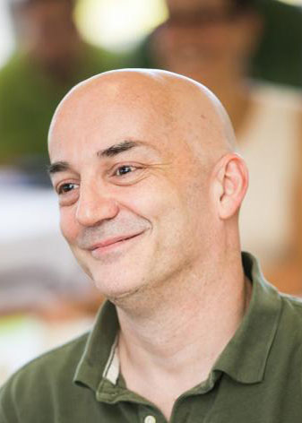
Teaching Faculty
  Assistant Professor of Computer Science: Joe Oppenheim
  Faculty Profile:
  https://www.corning-cc.edu/directory/oppenheim-joseph.php
  email: oppenheim@corning-cc.edu
Open House Fall 2020
We’re Here for You!

Slide 5

Teaching Faculty
  Instructor of Computer Science, Information Technology: System Administration: Matt Haas
  Faculty Profile:
  https://www.corning-cc.edu/directory/haas-matthew.php
  email: haas@corning-cc.edu
  e
Open House Fall 2020
We’re Here for You!

Slide 6

Teaching Faculty
  Instructor of Information Technology: Computers and Networking: Elmarine Jimenez
  Faculty Profile:
  https://www.corning-cc.edu/directory/jiminez-elmarine.php
  email: ejimene2@corning-cc.edu
  e
Open House Fall 2020
We’re Here for You!

Slide 7
Computing Programs
  Transfer Programs: Associate of Science (A.S.) Degree
    Computer Science, A.S and Cybersecurity, A.S.
    Both involve 2 years of full time study at CCC, then transfer for Bachelor’s Degree
Computer Science AS Computer Science is the study of computation and algorithms. Graduates from this program transfer to Bachelor’s programs to become software developers and software engineers, but this program is appropriate for transfer to many different Computer-related Bachelor’s programs. Also available: three year part time online Computer Science option. | CyberSecurity AS CyberSecurity is the study of testing, protecting, and defending computer systems and devices against security threats. CyberSecurity is a mix of nearly all disciplines, including programming, networking, and databases. This program prepares students for transfer to a Bachelor’s of CyberSecurity program. CyberSecurity is a lucrative growing field with more CyberSecurity jobs available than people qualified to fill them.
Open House Fall 2020
We’re Here for You!

Slide 8
Computing Programs
  Career Programs: Associate of Applied Science (A.A.S.) Degree
    Information Technology – Computers and Networking, A.A.S. and
    Information Technology – System Administration, A.A.S.
    Both involve 2 years of full time study at CCC, then enter the workforce (transfer also available)
Information Technology: Computer and Network Technology AAS Learn to build, troubleshoot, and repair computers and networks; deploy software and operating systems; and install and configure Cisco routers and switches. Students in this program work in a 100 hour internship with a local employer. This program is a good fit for students who are less interested in programming and want to solve real world problems supporting the computer and network infrastructure of an organization. | Information Technology: System Administration AAS Learn Linux system administration and C++, BASH, and SQL programming. Students in this program work in a 100 hour internship with a local employer. This program shares many courses with the Computer Science AS, but with a lower math requirement and a larger number of computer courses to better prepare students for the workforce. Also available: three year part time online IT: System Administration option.
Open House Fall 2020
We’re Here for You!

Slide 9
Computing Programs
  New Partnership: Game Design and Development Partnership with SUNY Canton
  Complete one year at CCC and then transfer to SUNY Canton for three years to complete a Bachelor’s in Game Design and Development.
  Contact: Joe DeLeone or DJ Dates
  me Design and Development Partnership with Game Design and Development Partnership with SUNY Canton
Open House Fall 2020
We’re Here for You!

Slide 10
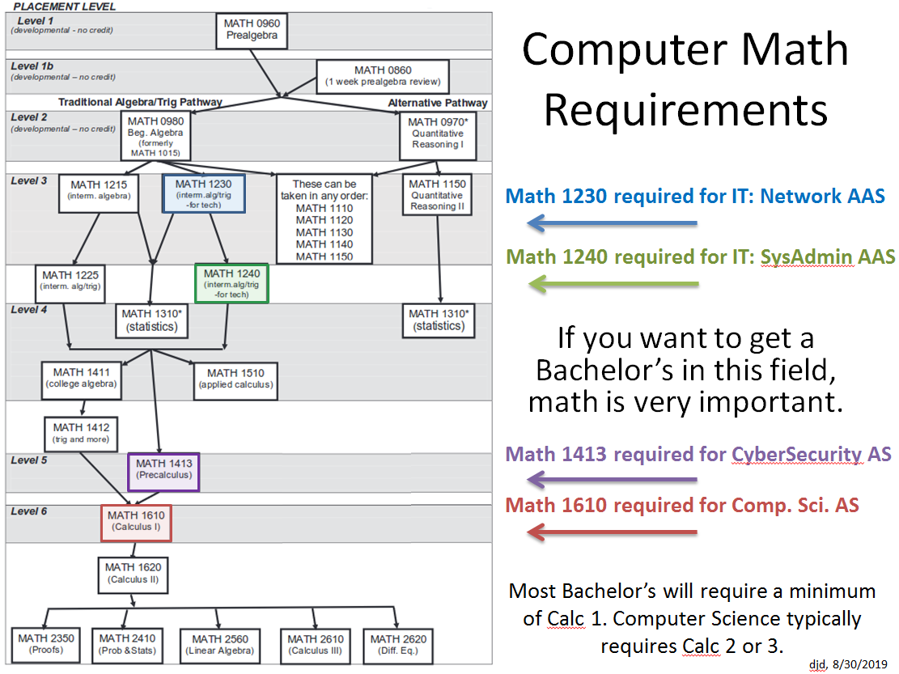
Computing Programs - Math
Open House Fall 2020
We’re Here for You!

Slide 11
Why Study at CCC?
  Strong student employment opportunities.
  Real world 100 hour internship experience with actual employers.
  Small class sizes. Personalized attention from faculty.
  A dedicated faculty exhibiting a wide range of diverse interests, experiences, and specialties.
  Training in on-demand areas: Problem Solving, Networking, System Administration.
  Heavy emphasis on hands-on, applied individual and team projects.
  Coursework aligned with market leading technologies and vendors.
  me Design and Development Partnership with Game Design and Development Partnership with SUNY Canton
Open House Fall 2020
We’re Here for You!

Slide 12
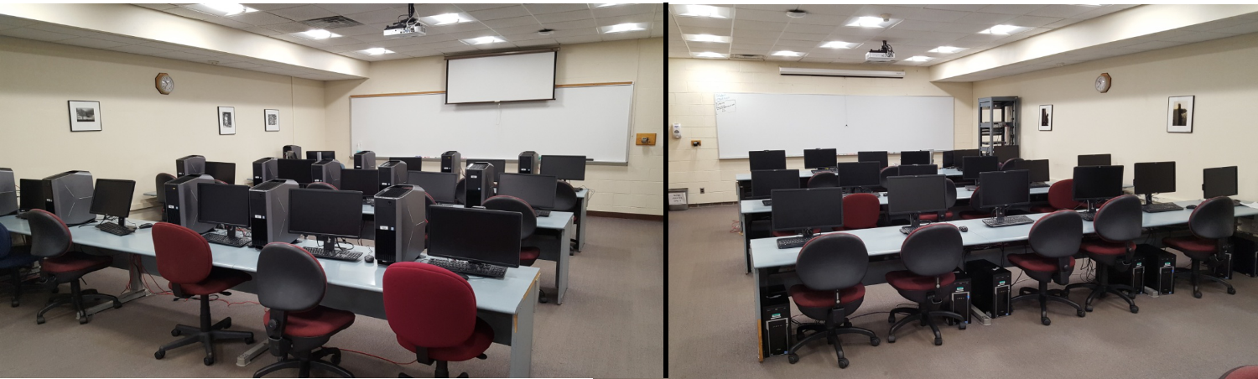
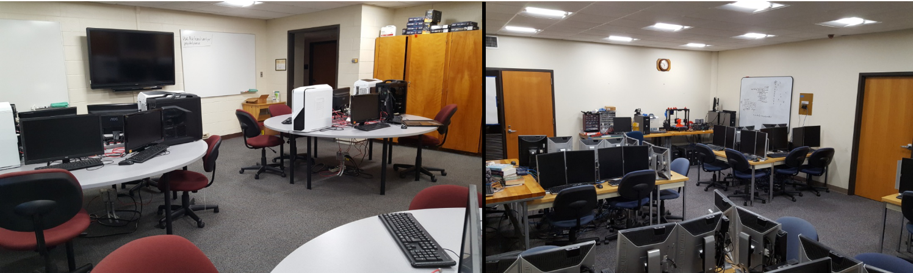
Computing Department Labs
Network Software/eSports
Networking Instruction
Computer Hardware/Cybersecurity
Linux and Programming

Slide 13
Salaries!
Computer Science Bachelor of Science (BS) Payscale.com National Salary Averages for employees with a Computer Science Bachelor’s degree Application Developer $64,000 Software Developer $67,000 Software Engineer $81,000 Solutions Architect $117,000 Software Engineering Manager $133,000 | CyberSecurity Bachelor of Science (BS) Payscale.com National Salary Averages for employees with a CyberSecurity Bachelor’s degree Information Security Analyst $65,000 Cyber Security Analyst $70,000 Penetration Tester $72,000 Cyber Security Engineer $81,000 Information Security Manager $95,000
Open House Fall 2020
We’re Here for You!

Slide 14
Salaries!
Information Technology Associate in Applied Science (AAS)
Payscale.com National Salary Averages for employees with an Information Technology AAS degree
Service Desk Analyst $41,000
Desktop Support Technician $48,000
Network Technician $48,000
Network Administrator $53,000
System Administrator, Windows $58,000
System Administrator, Linux $62,000
NYS Department of Labor Projections 2014-2024 for the Southern Tier – www.labor.ny.gov
User Support Specialist $38,470 to $63,360 annually
9.9% Regional Growth, 12.8% National Growth
Computer Network Support Specialist $44,110 to $76,000 annually
7.1% Regional Growth, 7.5% National Growth
Open House Fall 2020
We’re Here for You!

Slide 15
Program Pages
  Computer Science:
    https://www.corning-cc.edu/academics/computer-science/index.php
  Cybersecurity:
    https://www.corning-cc.edu/academics/cybersecurity/index.php
  Information Technology (pages 62 and 63):
    https://www.corning-cc.edu/_resources/img/catalog_2020_2021_final_2020_03.pdf#page=62
  me Design and Development Partnership with Game Design and Development Partnership with SUNY Canton
Open House Fall 2020
We’re Here for You!

